Slide 1

AGENDA
Introduction of Software Testing
Definition of software testing
Needs of software testing
Error-Failures-Defect
Causes of Software Defect
Cost of Software Defects
Importance of Software testing
Testing and Quality
7principals of Software testing
Economic testing

Slide 2

Introduction Of Software Testing
Software testing is nothing but an art of investigating software to ensure that its quality under test is in line with the requirement of the client.
Software testing is carried out in a systematic manner with the intent of finding defects in a system. It is required for evaluating the system.
Software testing is required to check the reliability of the software
Software testing ensures that the system is free from any bug that can cause any kind of failure
Software testing ensures that the product is in line with the requirement of the client

Slide 3
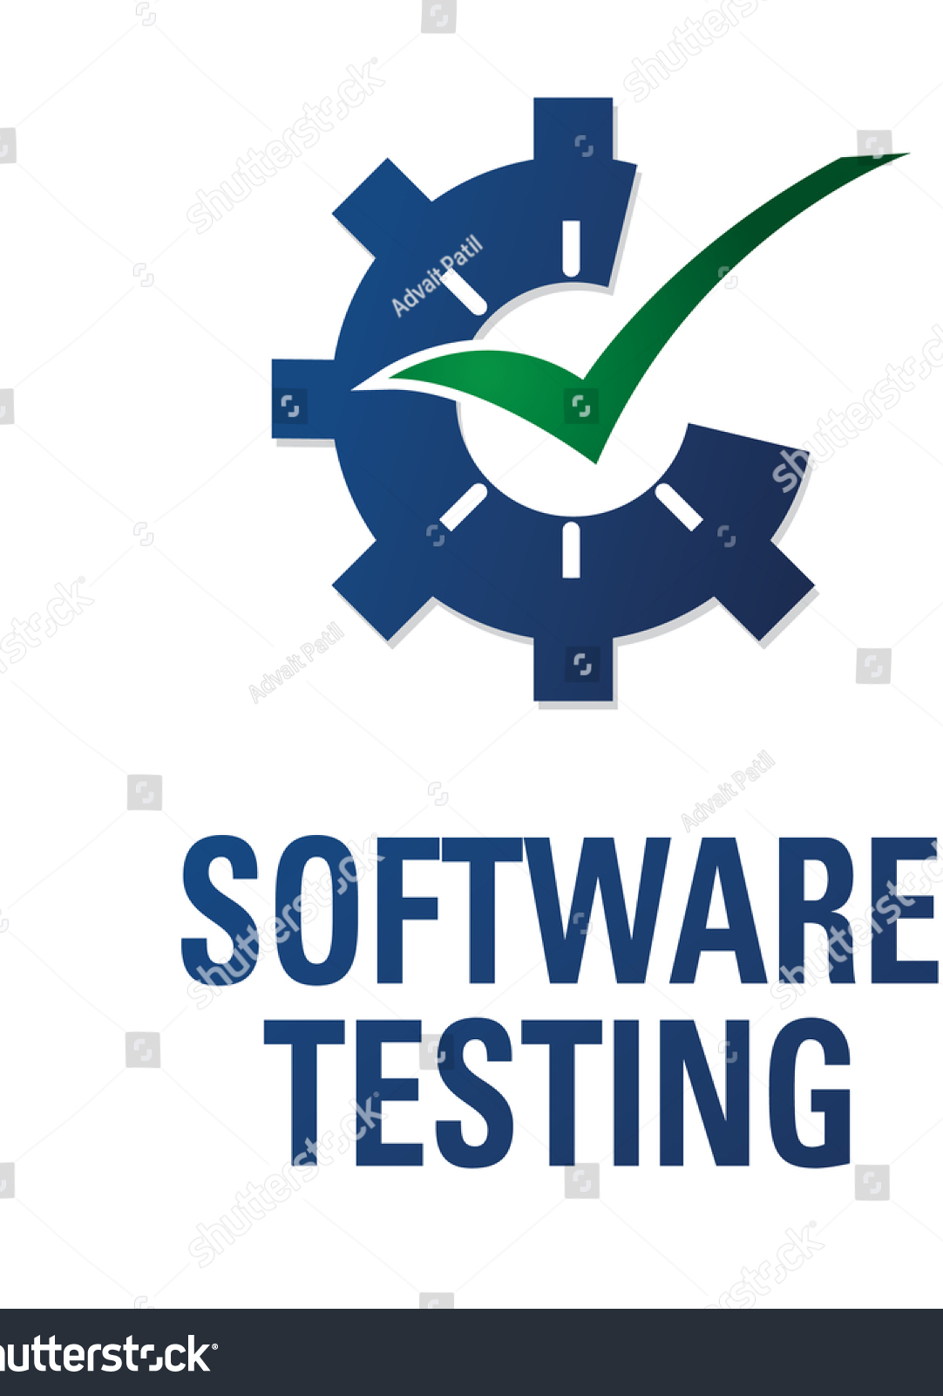
Definition Of Software Testing
The process or method of finding error/s in a software application or program so that the application functions according to the end user's requirement is called software testing.
Software testing is the performed to verify that the completed software package functions according to the expectations defined by the requirements/specifications.

Slide 4
Needs Of Software Testing
To gain customer confidence
Cost effectiveness
security
To check software adaptability
To identify errors
To avoid risks

Slide 5
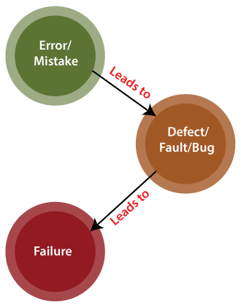
Error-Failure-Defect
Defect:
When the application is not working as per the requirement is knows as defects. It is specified as the aberration from the actual and expected result of the application or software.
Failure:
we can say that if an end-user detects an issue in the product, then that particular issue is called a failure.
Error:
The Problem in code leads to errors, which means that a mistake can occur due to the developer's coding error as the developer misunderstood the requirement or the requirement was not defined correctly. The developers use the term error.

Slide 6
Causes Of Software Defects:
Coding Errors
Lack of vision control
Poor software testing skills
Client-developer communication
Cost of software Defects:
the cost of defects can be measured by the impact of the defects and when we find them . Earlier the defect is found lesser is the cost of defect.
What does software testing reveal:
Software testing is the process of running software to determine whether it is performing as expected and discover any defects that might be causing it to malfunction or leaving it vulnerable.

Slide 7
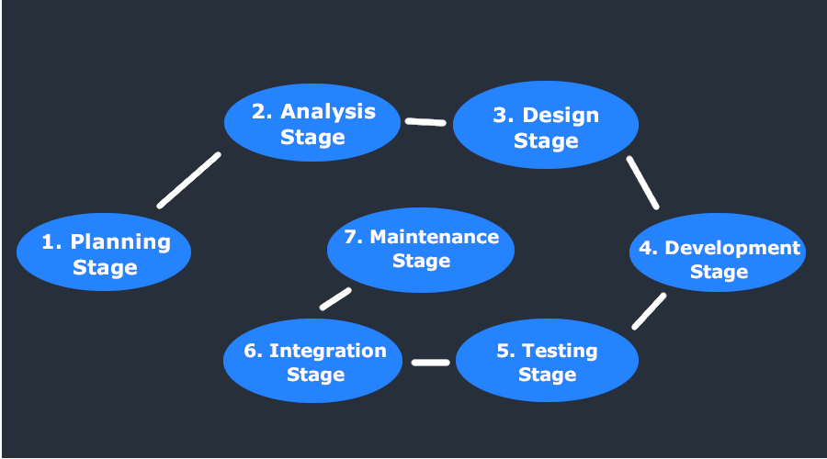
Importance of software testing
Increase the quality
We all make mistakes
Reduce risks
Cost Effective
Gain customer confidence
Importance in early testing
in SDLC phases

Slide 8
Testing and Quality
Testing:
Testing is the process or activity that checks the functionality and correctness of software according to specified user requirements in order to improve the quality and reliability of system. It is an expensive, time consuming, and critical approach in system development which requires proper planning of overall testing process.
Quality:
Quality refer to the conformance to implicit or explicit requirements, expectations and standad.

Slide 9

7 Principles of Software Testing
Testing shows presence of defects
Exhaustive testing is not possible
Early testing
Defect clustering
Pesticide paradox
Testing is context dependent
Absence of errors fallacy.
Economics testing:
Testing is about getting real feedback quickly, reducing wasteful testing activities, and putting a mirror in front of our applications. It becomes advantageous to understand the costs of these activities and direct the effort investment where it's most beneficial

Slide 10

THANK YOU

